Slide 2

PSALM 51+32

Slide 3
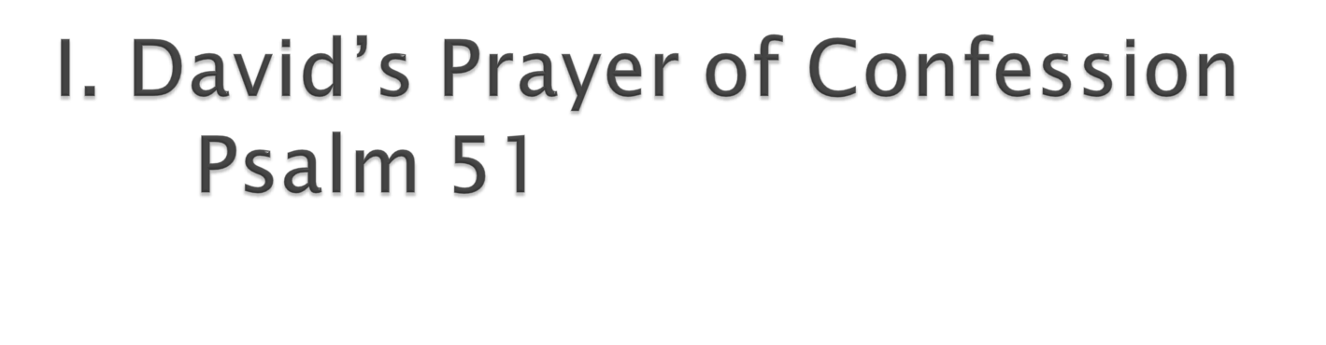

Slide 4
A. The cost of committing sin. vs.1-2

Slide 5
A. The cost of committing sin. vs. 1-2
B. The cost of confessing sin. vs. 5

Slide 6
A. The cost of committing sin. vs. 1-2
B. The cost of confessing sin. vs. 5
C. The cost of cleansing sin. vs. 16-17

Slide 7
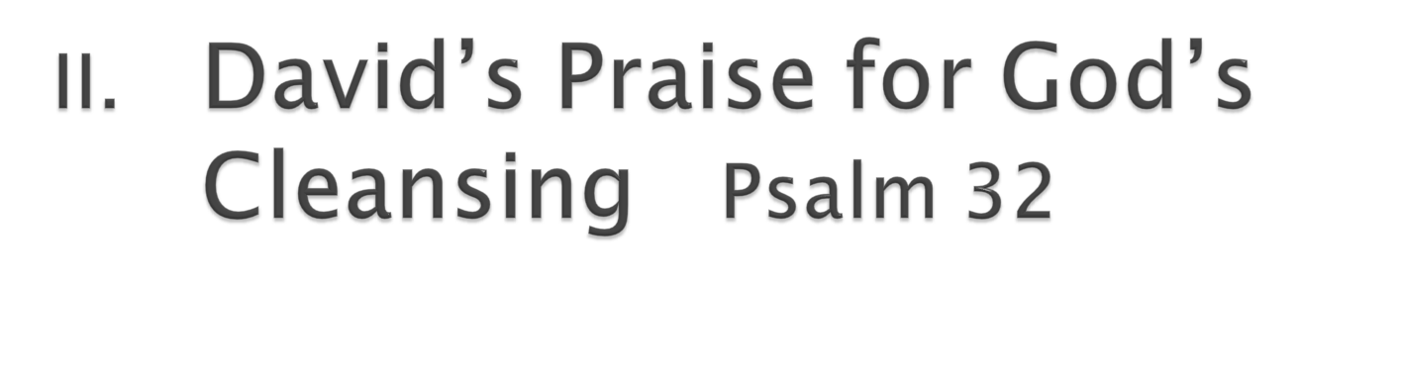

Slide 8
A. The silence of conviction (vs. 3–4)

Slide 9
A. The silence of conviction (vs. 3–4)
B. The cry of confession (vs. 5).

Slide 10
A. The silence of conviction (vs. 3–4)
B. The cry of confession (vs. 5).
C. The song of cleansing (vs. 6–7)

Slide 11
A. The silence of conviction (vs. 3–4)
B. The cry of confession (vs. 5).
C. The song of cleansing (vs. 6–7)
D. The shout of confidence (vs.8-11)

